Slide 1
Engineering Economy
Chapter 5: Evaluating a Single Project

Slide 2
The objective of Chapter 5 is to discuss and critique contemporary methods for determining project profitability.

Slide 3
Proposed capital projects can be evaluated in several ways.
Present worth (PW)
Future worth (FW)
Annual worth (AW)
Internal rate of return (IRR)
External rate of return (ERR)
Payback period (generally not appropriate as a primary decision rule)

Slide 4
To be attractive, a capital project must provide a return that exceeds a minimum level established by the organization. This minimum level is reflected in a firm’s Minimum Attractive Rate of Return (MARR).

Slide 5
Many elements contribute to determining the MARR.
Amount, source, and cost of money available
Number and purpose of good projects available
Perceived risk of investment opportunities
Type of organization

Slide 6
The most-used method is the present worth method.
The present worth (PW) is found by discounting all cash inflows and outflows to the present time at an interest rate that is generally the MARR.
A positive PW for an investment project means that the project is acceptable (it satisfies the MARR).

Slide 7
Present Worth Example
Consider a project that has an initial investment of $50,000 and that returns $18,000 per year for the next four years. If the MARR is 12%, is this a good investment?
PW = -50,000 + 18,000 (P/A, 12%, 4)
PW = -50,000 + 18,000 (3.0373)
PW = $4,671.40 → This is a good investment!

Slide 8
Bond value is a good example of present worth.
The commercial value of a bond is the PW of all future net cash flows expected to be received--the period dividend [face value (Z) times the bond rate (r)], and the redemption price (C), all discounted to the present at the bond’s yield rate, i%.
V_{N}=C (P/F, i%, N) + rZ (P/A, i%, N)

Slide 9
Bond example
What is the value of a 6%, 10-year bond with a par (and redemption) value of $20,000 that pays dividends semi-annually, if the purchaser wishes to earn an 8% return?
V_{N} = $20,000 (P/F, 4%, 20) + (0.03)$20,000 (P/A, 4%, 20)
V_{N} = $20,000 (0.4564) + (0.03)$20,000 (13.5903)
V_{N} = $17,282.18

Slide 10
Pause and solve
Bill Mitselfik wants to buy a bond. It has a face value of $50,000, a bond rate of 6% (nominal), payable semi-annually, and matures in 10 years. Bill wants to earn a nominal interest of 8%. How much should Bill pay for the bond?

Slide 11
Solution
Bond value equation
where

Slide 12
Capitalized worth is a special variation of present worth.
Capitalized worth is the present worth of all revenues or expenses over an infinite length of time.
If only expenses are considered this is sometimes referred to as capitalized cost.
The capitalized worth method is especially useful in problems involving endowments and public projects with indefinite lives.

Slide 13
The application of CW concepts.
The CW of a series of end-of-period uniform payments A, with interest at i% per period, is A(P/A, i%, N). As N becomes very large (if the A are perpetual payments), the (P/A) term approaches 1/i. So, CW = A(1/i).

Slide 14
Pause and solve
Betty has decided to donate some funds to her local community college. Betty would like to fund an endowment that will provide a scholarship of $25,000 each year in perpetuity, and also a special award, “Student of the Decade,” each ten years (again, in perpetuity) in the amount of $50,000. How much money does Betty need to donate today, in one lump sum, to fund the endowment? Assume the fund will earn a return of 8% per year.

Slide 15
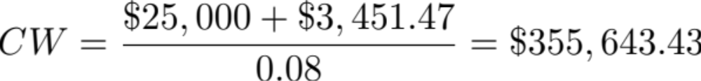
Solution
First, convert “Student of the Decade” funds into an equivalent annual amount over the ten years.
We can add this to the annual scholarship and then use capitalized worth to bring it all back to time zero.

Slide 16
Future Worth (FW) method is an alternative to the PW method.
Looking at FW is appropriate since the primary objective is to maximize the future wealth of owners of the firm.
FW is based on the equivalent worth of all cash inflows and outflows at the end of the study period at an interest rate that is generally the MARR.
Decisions made using FW and PW will be the same.

Slide 17
Future worth example.
A $45,000 investment in a new conveyor system is projected to improve throughput and increasing revenue by $14,000 per year for five years. The conveyor will have an estimated market value of $4,000 at the end of five years. Using FW and a MARR of 12%, is this a good investment?
FW = -$45,000(F/P, 12%, 5)+$14,000(F/A, 12%, 5)+$4,000
FW = -$45,000(1.7623)+$14,000(6.3528)+$4,000
FW = $13,635.70 → This is a good investment!

Slide 18
Annual Worth (AW) is another way to assess projects.
Annual worth is an equal periodic series of dollar amounts that is equivalent to the cash inflows and outflows, at an interest rate that is generally the MARR.
The AW of a project is annual equivalent revenue or savings minus annual equivalent expenses, less its annual capital recovery (CR) amount.

Slide 19
Capital recovery reflects the capital cost of the asset.
CR is the annual equivalent cost of the capital invested.
The CR covers the following items.
  Loss in value of the asset.
  Interest on invested capital (at the MARR).
The CR distributes the initial cost (I) and the salvage value (S) across the life of the asset.

Slide 20

A project requires an initial investment of $45,000, has a salvage value of $12,000 after six years, incurs annual expenses of $6,000, and provides an annual revenue of $18,000. Using a MARR of 10%, determine the AW of this project.
Since the AW is positive, it’s a good investment.

Slide 21
Internal Rate of Return
The internal rate of return (IRR) method is the most widely used rate of return method for performing engineering economic analysis.
It is also called the investor’s method, the discounted cash flow method, and the profitability index.
If the IRR for a project is greater than the MARR, then the project is acceptable.

Slide 22
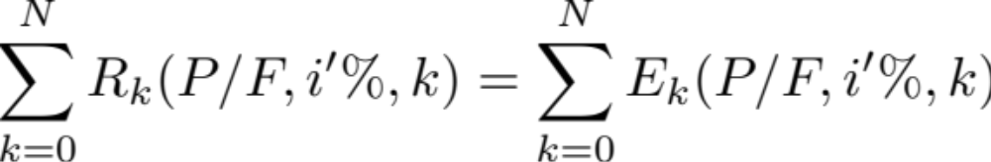
How the IRR works
The IRR is the interest rate that equates the equivalent worth of an alternative’s cash inflows (revenue, R) to the equivalent worth of cash outflows (expenses, E).
The IRR is sometimes referred to as the breakeven interest rate.
The IRR is the interest i'% at which

Slide 23
Solving for the IRR is a bit more complicated than PW, FW, or AW
The method of solving for the i'% that equates revenues and expenses normally involves trial-and-error calculations, or solving numerically using mathematical software.
The use of spreadsheet software can greatly assist in solving for the IRR. Excel uses the IRR(range, guess) or RATE(nper, pmt, pv) functions.

Slide 24
Challenges in applying the IRR method.
It is computationally difficult without proper tools.
In rare instances multiple rates of return can be found. (See Appendix 5-A.)
The IRR method must be carefully applied and interpreted when comparing two more mutually exclusive alternatives (e.g., do not directly compare internal rates of return).

Slide 25
Reinvesting revenue—the External Rate of Return (ERR)
The IRR assumes revenues generated are reinvested at the IRR—which may not be an accurate situation.
The ERR takes into account the interest rate, ε, external to a project at which net cash flows generated (or required) by a project over its life can be reinvested (or borrowed). This is usually the MARR.
If the ERR happens to equal the project’s IRR, then using the ERR and IRR produce identical results.

Slide 26
The ERR procedure
Discount all the net cash outflows to time 0 at ε% per compounding period.
Compound all the net cash inflows to period N at at ε%.
Solve for the ERR, the interest rate that establishes equivalence between the two quantities.

Slide 27
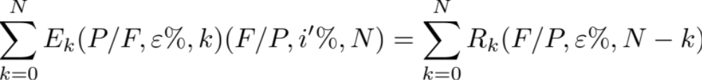
ERR is the i'% at which
where
R_{k} = excess of receipts over expenses in period k,
E_{k} = excess of expenses over receipts in period k,
N = project life or number of periods, and
ε = external reinvestment rate per period.

Slide 28

Applying the ERR method
For the cash flows given below, find the ERR when the external reinvestment rate is ε = 12% (equal to the MARR).
Year | 0 | 1 | 2 | 3 | 4
Cash Flow | -$15,000 | -$7,000 | $10,000 | $10,000 | $10,000
Expenses
Revenue
Solving, we find

Slide 29
The payback period method is simple, but possibly misleading.
The simple payback period is the number of years required for cash inflows to just equal cash outflows.
It is a measure of liquidity rather than a measure of profitability.

Slide 30
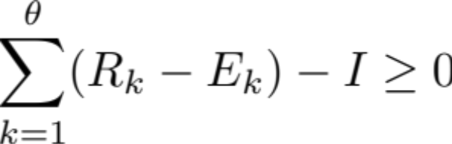
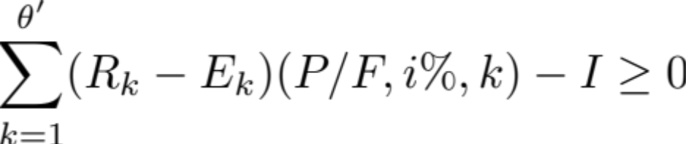
Payback is simple to calculate.
The payback period is the smallest value of θ (θ ≤ N) for which the relationship below is satisfied.
For discounted payback future cash flows are discounted back to the present, so the relationship to satisfy becomes

Slide 31
Problems with the payback period method.
It doesn’t reflect any cash flows occurring after θ, or θ'.
It doesn’t indicate anything about project desirability except the speed with which the initial investment is recovered.
Recommendation: use the payback period only as supplemental information in conjunction with one or more of the other methods in this chapter.

Slide 32
Finding the simple and discounted payback period for a set of cash flows.
End of Year | Net Cash Flow | Cumulative PW at 0% | Cumulative PW at 6%
0 | -$42,000 | -$42,000 | -$42,000
1 | $12,000 | -$30,000 | -$30,679
2 | $11,000 | -$19,000 | -$20,889
3 | $10,000 | -$9,000 | -$12,493
4 | $10,000 | $1,000 | -$4,572
5 | $9,000 |  | $2,153
The cumulative cash flows in the table were calculated using the formulas for simple and discounted payback.
From the calculations θ = 4 years and θ' = 5 years.

